Slide 1
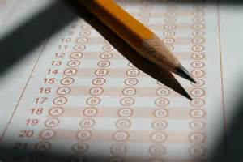
Test and Types of Tests

Slide 2
What types of test do you commonly use? 2. Which do you often use? Why? 3. Which do you seldom use? Why? 4. What do you consider when choosing the type of test that you will use?
In a triad, discuss the following:

Slide 3
Types of Tests
Essay
Completion
Matching type
Multiple-choice test
Product/ Performance test

Slide 4
Essay Test
consists of a small number of questions to which the student is expected to demonstrate his/her ability to
(a) recall factual knowledge,
(b) organize this knowledge and
(c) present the knowledge in a logical, integrated answer to the
question
either an extended-response essay item or a short-answer essay item

Slide 5
Essay test
ADVANTAGES
Easy to construct
Demonstrates students’ ability to organize knowledge, express opinions and show originality
Minimizes guessing
Stimulates superior study methods
DISADVANTAGES
Limited sampling of the material covered
Inadequate scoring key can make the scoring subjective and unreliable
Scoring may be extremely time-consuming

Slide 6
Writing Essay Test Items
Identify the type of behavior you want to measure
Student's TASK is clearly indicated - underline critical words such as “compare,” “contrast,” “criticize,” and “evaluate”
Indicate a point value or weight and an estimated time limit for answering
Avoid giving the student a choice among optional items as this greatly reduces the reliability of the test

Slide 7
Completion Test Items
requires the student to answer a question or to finish an incomplete statement by filling in a blank with the correct word or phrase
ADVANTAGES
provides a wide sampling of content
efficiently measures lower levels of cognitive ability
minimizes guessing as compared to multiple-choice or true-false items
provides an objective measure of student achievement or ability

Slide 8
Completion Test Items
DISADVANTAGES
Difficult to construct such that the desired response is clearly indicated
Difficulty in measuring learning objectives requiring more than simple recall of information

Slide 9
Completion Test Items
DISADVANTAGES
Time consuming to score when compared to multiple-choice or true-false items
More difficult to score since more than one answer may have to be considered correct if the item was not properly prepared.

Slide 10
Writing Completion Test Items
Omit only significant words from the statement
Do not omit so many words from the statement that the intended meaning is lost
Be sure there is only one correct response
Make the blanks of equal length
Avoid lifting statements directly from the text, lecture or other sources

Slide 11
Multiply-choice Test
test question which has a number of alternative choices from which the examinee is to select the correct answer
uses 4 or 5 choices per question, fewer alternatives often results in items with inferior characteristics
assesses many levels of learning as well as a test taker's ability to integrate information
considered as the strongest predictors of overall student performance compared with other forms of evaluations

Slide 12
Multiply-choice test
Parts of multiply-choice test
STEM - part of the item in which the problem is stated for the examinee
a question,
a set of directions or
a statement with an embedded blank
OPTIONS/ALTERNATIVES - choices given for the item
Key - correct choice for the item
Distractors - incorrect choices for the item

Slide 13
Multiply-choice Test
ADVANTAGES
utility, reliability, and cost effectiveness
can be used with different knowledge areas and skills
minimum writing; needs less time to answer
easy scoring
objective assessment items – minus teacher’s bias
can easily diagnose a test taker's difficulty with certain concepts

Slide 14
Multiply-choice Test
DISADVANTAGES
limited types of knowledge ; lower-order skills
questions phrased ambiguously may cause test-taker confusion
one answer may encapsulate a collection of previous options
possible ambiguity in the examinee's interpretation of the item
quality and quantity of distracters

Slide 15
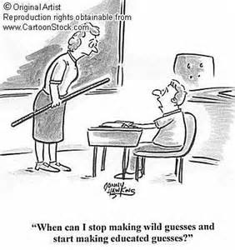
Multiply-choice test
DISADVANTAGES
difficult to construct
time-consuming to construct
do not allow test takers to demonstrate knowledge beyond the choices provided
may encourage guessing or approximation due to the presence of at least one correct answer
do not test a test taker's attitudes towards learning because correct responses can be easily faked

Slide 16
Writing the Multiple-Item Test
Consider the item as a whole
it measures knowledge or a skill component which is worthwhile and appropriate for the examinees who will be tested;
there is a markedly better way to test what this item tests;
it is of the appropriate level of difficulty for the examinees who will be tested.
Notes:
When you review an item, write your comments on a copy of the item indicating your suggested changes. If you believe an item is not worth retaining, suggest it be deleted.

Slide 17
Writing the Multiple-Item Test
Consider the stem
clearly defined question, problem or task;
does not contain unnecessary information;
worded simply, clearly and concisely

Slide 18
Writing the Multiple-Item Test
Consider the key
best answer among the set of options for the item;
actually answers the question posed in the stem;
not too obviously relative to the other alternatives (with same length, number of details, grammatical structure)

Slide 19
Writing the Multiple-Item Test
Consider the distractors
examinees could justify one or more as acceptable correct answer;
plausible enough to be attractive for examinees who are misinformed or ill-prepared;
does not call attention to the key (no distractor should merely state the reverse of the key or resemble the key very closely unless another pair of choices is similarly parallel or involves opposites)

Slide 20
True/False Test
for knowledge level learning
for understanding of popular misconceptions
when 2 logical responses are possible
ADVANTAGES
answers many questions in short time
scoring efficiency and accuracy
versatility in measuring all levels of cognitive ability
highly reliable test scores
objective measurement of student achievement or ability

Slide 21
True/False Test
DISADVANTAGES
easy; might not discriminate well
low reliability - student has 50-50 chance of correct guess
Possibility of confusing statements due to the difficulty of writing statements which are explicitly true or false
can often lead an instructor to favor testing of trivial knowledge

Slide 22
Constructing True/False Test
Base true-false items upon statements that are absolutely true or false, without qualifications or exceptions
Avoid lifting statements from the text, lecture or other materials
Specific determiners should be used with caution like all, always, none, never, impossible, inevitable, etc.

Slide 23
Constructing True/False Test
Include only one central idea is each statement
Avoid emphasizing trivial parts
Do not use controversial issues
Use greater number of false than true statements (false items tend to discriminate more highly than true items)

Slide 24
Matching Type Test
Tests knowledge level learning of the who, what, when, where variety
ADVANTAGES
Maximum coverage of knowledge level learning with a minimum of space and preparation time
Valuable in subject fields in which a great variety of facts must be learned
provide scoring efficiency and accuracy
DISADVANTAGES
Not well suited for measuring higher level learning outcomes
Difficult to construct due to the problem of selecting a common set of stimuli and responses

Slide 25
Matching Type Test
TYPES OF MATCHING
Terms or words with Definitions
Symbols with Names
Causes with Effects
Problems with Solution
Parts with Unit to which they belong

Slide 26
Writing Matching Type Test
Include directions which clearly state the basis for matching the stimuli with the responses
Arrange the list of responses in some systematic order if possible (e.g., chronological, alphabetical)

Slide 27
Product/Performance Test
requires an examinee to come up with output;
designed to assess the ability of a student to perform correctly in a simulated situation (i.e., a situation in which the student will be ultimately expected to apply his/her learning)
concept of simulation is central in performance testing
Example:
Product: making a timeline of World War II
Performance: delivery of an oration

Slide 28
Product/Performance Test
ADVANTAGES
Measure learning objectives which focus on the ability of the students to apply skills or knowledge in real life situations
Provide a degree of test validity NOT possible with standard paper and pencil test items

Slide 29
Product/Performance Test
DISADVANTAGES
Difficult and time consuming to construct
Used for testing students individually and not for testing groups - relatively costly, time consuming and inconvenient forms of testing
Do not provide objective measure of student achievement or ability (subject to bias on the part of the observer/grader)

Slide 30
Writing Performance Test Items
Elicit the type of output or behavior you want to measure
Identify and explain the simulated situation to the student
Make the simulated situation as "life-like" as possible
Directions clearly inform the students of type of response called for (whether product or performance) through a rubric
State time and activity limitations in the directions
Train the observer(s)/scorer(s) to ensure that they are fair in scoring the appropriate output/behaviors

Slide 31
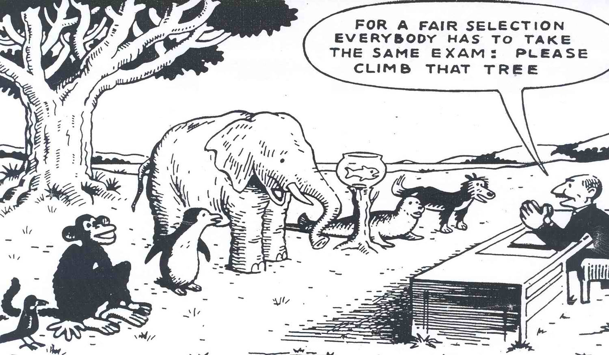
Choosing the Right Type of Test

Slide 32
Test Plan
What objectives do you want to cover?
How difficult should you make the test?
Who is taking the test?
How much time has been provided for testing?
How many questions should you have on your test?
What type of questions should be included in the test?

Slide 33
Item format
indicates the kinds of skills and the balance of test content to be measured
Example: multiple-choice questions may make sense for testing knowledge of the mechanics of a language BUT not a direct measure of writing skill
based on the kinds of skills to be measured and NOT on some personal like or dislike for a particular item format
No inherent goodness or badness in any type of question format

Slide 34
Criteria to Consider
Goal-centered
Learner-centered
Context-centered
Assessment-centered

Slide 35
Criteria in Choosing Test Items
Goal-Centered Criteria
congruent with the terminal and performance objectives by matching the behavior involved
test item should measure the exact behavior and response stated in the objective
performance of an objective states that learners will be able to state or define a term, the assessment item should ask them to state or define the term, not to choose the definition from a list of answers.
Notes:
point of testing is to be able to predict whether your learners will be able to do what you want them to do when they leave you, and the best way to do that is to observe the actual performance that you are trying to develop

Slide 36
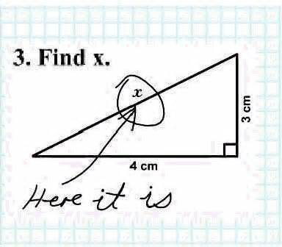

Slide 37
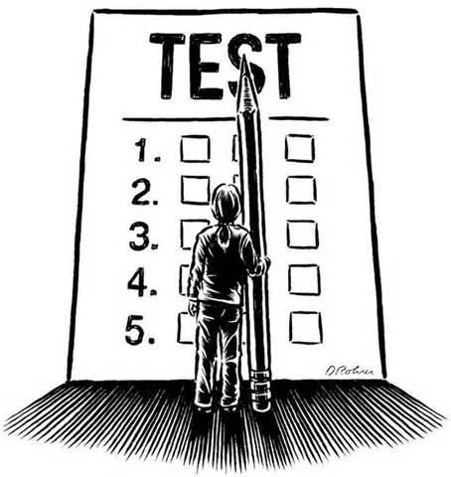
Criteria in Choosing Test Items
Learner-Centered Criteria
consideration the characteristics and needs of the learners
learners’ vocabulary and language levels,
motivational and interest levels,
experiences and backgrounds, and
special needs
free of any gender, racial, or cultural bias

Slide 38
Criteria in Choosing Test Items
Context-Centered Criteria
Consider both performance context and the learning context
Make test items as realistic and close to the performance setting as possible - transfer of skills from the learning environment to the eventual performance environment
Dick and Carey, "the more realistic the testing environment, the more valid the learners’ responses will be“

Slide 39
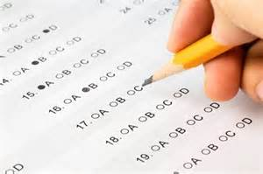
Criteria in Choosing Test Items
Assessment-Centered Criteria
Test items should be well written and free of spelling, grammar and punctuation errors
Directions should be clearly written to avoid any confusion on the part of the learner.
Avoid writing "tricky" questions that feature double negatives, deliberately confusing directions, or compound questions
learners should miss questions because they do not have the necessary skill, not because your directions were unclear, or because you wanted to throw them off with unclear wording

Slide 40
Responsibilities of TEST ITEM WRITERS

Slide 41
Continuously develop new items
Review and select items for inclusion in the written examination
Monitor the content, task and cognitive skill distributions of items
Monitor the content quality and difficulty of each item and avoid duplicate items on the same knowledge/skill
Provide expert input into the criterion standard against which competencies are measured

Slide 42
Complete the statement
In this session I realized/ discovered that__________
therefore I will __________.

Slide 43
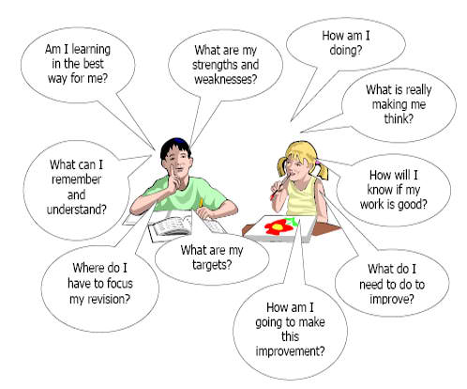
Remember our learners

